Slide 1


Differential Evolution
Jagdish Chand Bansal
South Asian University New Delhi and
Liverpool Hope University UK
jcbansal@gmail.com
Formerly, ABV-IIITM Gwalior

Slide 2
Introduction
Diﬀerential evolution (DE) is a stochastic, population-based search strategy developed by Storn and Price in 1995
While DE shares similarities with other evolutionary algorithms (EA), it diﬀers signiﬁcantly in the sense that distance and direction information from the current population is used to guide the search process
Storn, Rainer, and Kenneth Price. "Differential evolution–a simple and efficient heuristic for global optimization over continuous spaces." Journal of global optimization 11, no. 4 (1997): 341-359.

Slide 3
Main steps of DE

Slide 4
Basic Diﬀerential Evolution
DE diﬀers from the evolutionary algorithms:
Mutation is applied ﬁrst to generate a trial vector, which is then used within the crossover operator to produce one oﬀspring, (While in EAs crossover is applied first and then mutation)
Mutation step sizes are not sampled from a prior known probability distribution function (while in EAs mutation and crossover both are sampled from some probability function)
In DE, mutation step sizes are inﬂuenced by diﬀerences between individuals of the current population

Slide 5
Forming basis of DE
The positions of individuals provide valuable information about the ﬁtness
Over time, as the search progresses, the distances between individuals become smaller, with all individuals converging to the same solution
The magnitude of the initial distances between individuals is inﬂuenced by the size of the population
The more individuals in a population, the smaller the magnitude of the distances.

Slide 6
Forming basis of DE (Cont.)
Distances between individuals are a very good indication of the diversity of the current population
If there are large distances between individuals, it stands to reason that individuals should make large step sizes in order to explore as much of the search space as possible
On the other hand, if the distances between individuals are small, step sizes should be small to exploit local areas

Slide 7
Forming basis of DE (Cont.)
It is this behaviour that is achieved by DE in calculating mutation step sizes as weighted diﬀerences between randomly selected individuals
The ﬁrst step of mutation is therefore to ﬁrst calculate one or more diﬀerence vectors, and then to use these diﬀerence vectors to determine the magnitude and direction of step sizes

Slide 8

Forming basis of DE (Cont.)
Using vector diﬀerentials to achieve variation has a number of advantages:
Firstly, information about the ﬁtness landscape, as represented by the current population, is used to direct the search
Secondly, due to the central limit theorem, mutation step sizes (which is a random variable in each iteration) approaches a Gaussian (Normal) distribution, provided that the population is suﬃciently large to allow for a good number of diﬀerence vectors
The central limit theorem states that the probability distribution governing a random variable approaches the Normal distribution as the number of samples of that random variable tends to inﬁnity

Slide 9

Forming basis of DE (Cont.)
The mean of the distribution formed by the diﬀerence vectors are always zero, provided that individuals used to calculate diﬀerence vectors are selected uniformly from the population
Under the condition that individuals are uniformly selected, this characteristic follows from the fact that diﬀerence vectors (x_{i1} − x_{i2}) and (x_{i2} − x_{i1} ) occur with equal frequency, where x_{i1} and x_{i2} are two randomly selected individuals
The zero mean of the resulting step sizes ensures that the population will not suﬀer from genetic drift
Genetic Drift: The process of change in genetic composition of a population due to chance or random events rather than natural selection.

Slide 10
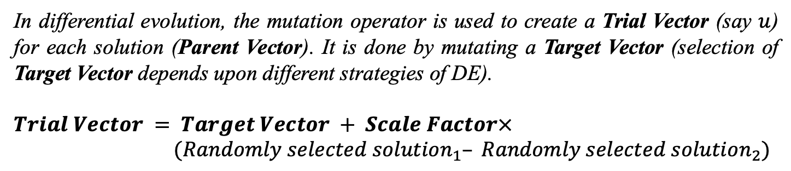
DE Operators (Mutation)
In differential evolution, the mutation operator is used to create a Trial Vector (say $u$) for each solution (Parent Vector). It is done by mutating a Target Vector (selection of Target Vector depends upon different strategies of DE).
$Trial Vector = Target Vector + Scale Factor× (Randomly selected solution_{1}– Randomly selected solution_{2})$
Diﬀerent approaches can be used to select the target vector and to calculate diﬀerentials which results different strategies of DE

Slide 11
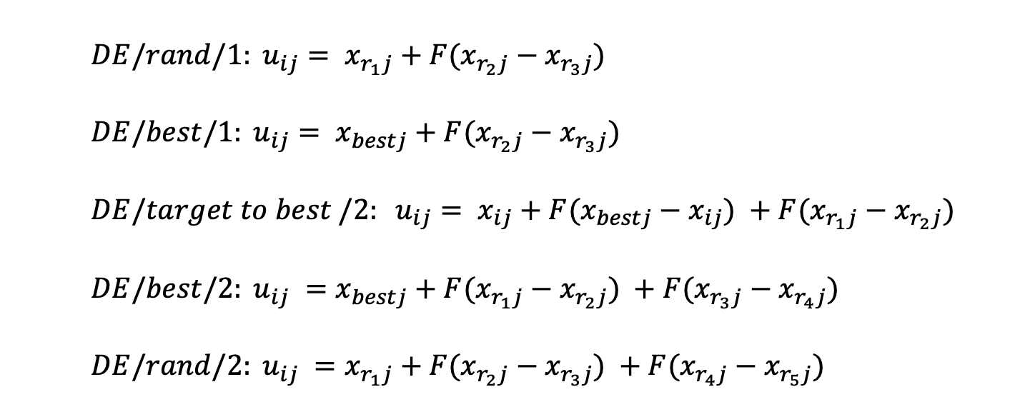
DE Strategies
Five different mutation schemes, suggested by Storn and Price are summarized below:
$DE/rand/1: {u_{ij}= x}_{r_{1}j}+F(x_{r_{2}j}−x_{r_{3}j})$
$DE/best/1: {u_{ij}= x}_{bestj}+F(x_{r_{2}j}−x_{r_{3}j})$
$DE/target to best /2: u_{ij}= x_{ij}+F(x_{bestj}−x_{ij}) +F(x_{r_{1}j}−x_{r_{2}j})$
$DE/best/2: u_{ij} =x_{bestj}+F(x_{r_{1}j}−x_{r_{2}j}) +F(x_{r_{3}j}−x_{r_{4}j})$
$DE/rand/2: u_{ij} =x_{r_{1}j}+F(x_{r_{2}j}−x_{r_{3}j}) +F(x_{r_{4}j}−x_{r_{5}j})$

Slide 12
DE Strategies
Storn and Price suggested total ten different working strategies of DE.
These strategies were derived from the five different DE mutation schemes.
Each mutation strategy was combined with either the ‘exponential’ type crossover or the ‘binomial’ type crossover.
1. DE/best/1/exp 2.DE/rand/1/exp
3. DE/target-to-best/1/exp 4. DE/best/2/exp 5. DE/rand/2/exp 6. DE/best/1/bin
7. DE/rand/1/bin 8. DE/target-to-best/1/bin
9. DE/best/2/bin 10. DE/rand/2/bin

Slide 13
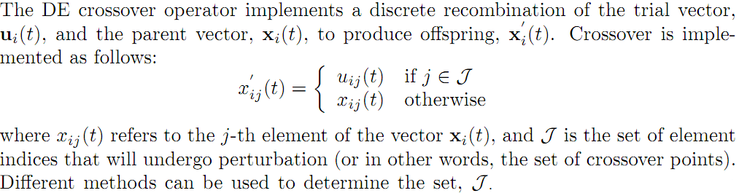
DE Operators (Crossover)
When two organisms mate they share their genes. The resultant offspring may end up having half the genes from one parent and half from the other. This process is called recombination.

Slide 14
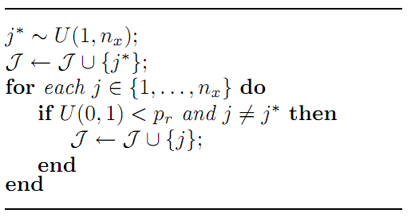
DE Operators (Binomial Crossover)
The crossover points are randomly selected from the set of possible crossover points, {1, 2,...,n_{x}},where n_{x} is the problem dimension
p_{r} is the probability that the considered crossover point will be included
The larger the value of p_{r}, the more crossover points will be selected compared to a smaller value
This means that more elements of the trial vector will be used to produce the oﬀspring, and less of the parent vector

Slide 15
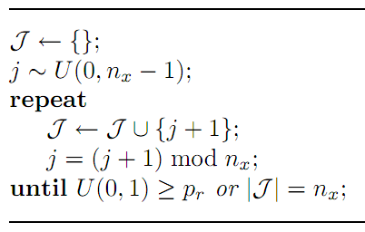
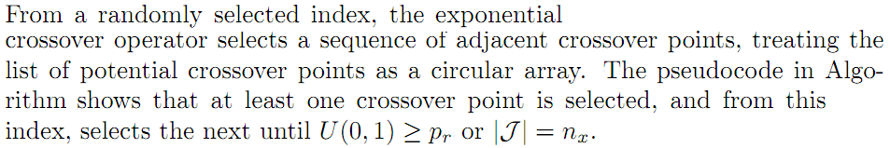
DE Operators (Exponential Crossover)

Slide 16



DE Operators (Selection)
Selection is applied to determine which individuals will take part in the mutation operation to produce a trial vector, and to determine which of the parent or the oﬀspring will survive to the next generation.
With reference to the mutation operator, a number of selection methods have been used. Random selection is usually used to select the individuals from which diﬀerence vectors are calculated. For most DE implementations the target vector is either randomly selected or the best individual is selected.
To construct the population for the next generation, deterministic selection is used: the oﬀspring replaces the parent if the ﬁtness of the oﬀspring is better than its parent; otherwise the parent survives to the next generation. This ensures that the average ﬁtness of the population does not deteriorate.

Slide 17
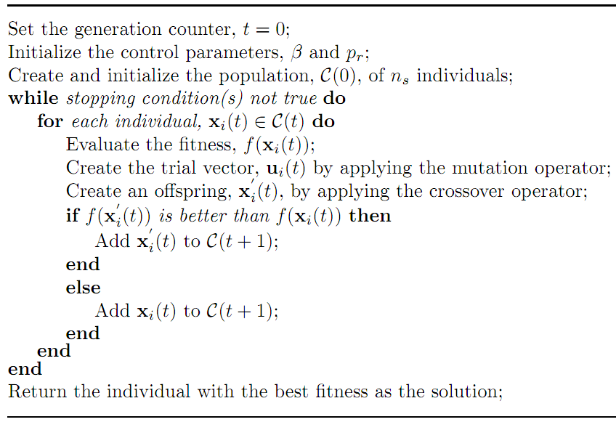
DE Algorithm

Slide 18
Control Parameters (Population Size)
The size of the population has a direct inﬂuence on the exploration ability of DE algorithms.
The more individuals there are in the population, the more diﬀerential vectors are available, and the more directions can be explored.
However, it should be kept in mind that the computational complexity per generation increases with the size of the population
Empirical studies provide the guideline that n_{s} ≈ 10n_{x}
However, a lower bound on the number of individuals can be set as as n_{s} > 2n_{v} +1,where n_{v} is the number of diﬀerentials used
For n_{v} diﬀerentials, 2n_{v} diﬀerent individuals are required, 2 for each diﬀerential. The additional individual represents the target vector

Slide 19
Performance
There is no proof of convergence for DE
However it has been shown to be effective on a large range of classic optimisation problems
In a comparison by Storn and Price in 1997 DE was more efficient than simulated annealing and genetic algorithms

